Slide 1

Machine Learning Task 1
By
Amro Gamar
Julia Maged
Omar Hamdy Ahmed
Abdullah Ahmed Sayed
Mark Maged Botros

Slide 2

Overview
Seasonal insights
Market segmentation analysis
Booking insights
Effect of meal plan & Room Type on price
Features correlation
Outlier Detection

Slide 3
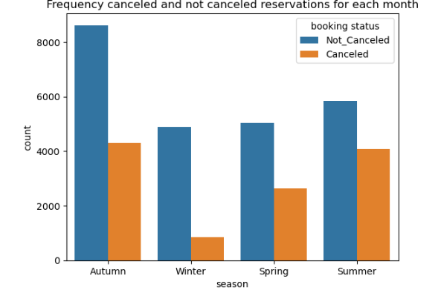
SEASONAL insights
Illustration of the frequency of canceled and not canceled reservations across different seasons: Autumn, Winter, Spring, and Summer. It helps us understand booking trends and customer behavior throughout the year.

Slide 4
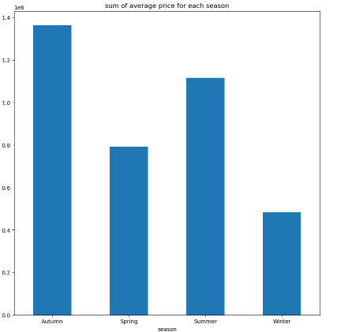
SEASONAL insights
Shows the average spending in different months within different years

Slide 5
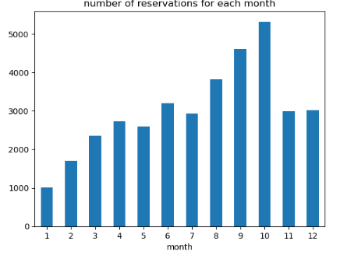
Monthly reservations
What is the peak month for hotel bookings based on occupancy data?

Slide 6
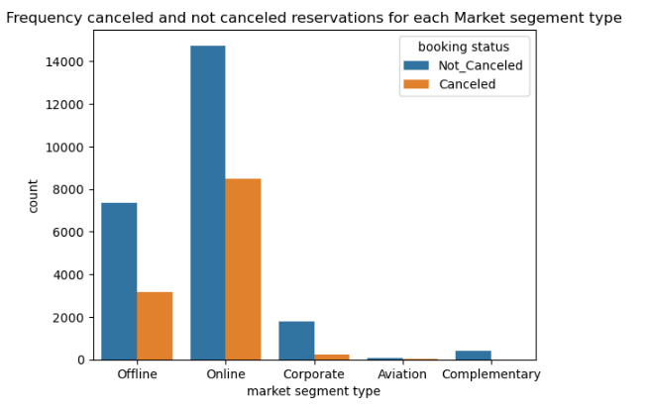
MARKET SEGMENT ANALYSIS
The data shows that the Online market segment has the highest number of both canceled and not canceled reservations. This could be due to the convenience and accessibility of online booking platforms.

Slide 7
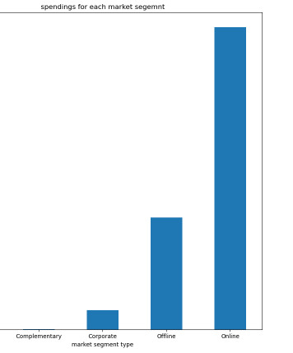
MARKET SEGMENT ANALYSIS
compare the total spending across different market segments at a glance. helps in identification of which market segment contributes the most to the revenue

Slide 8
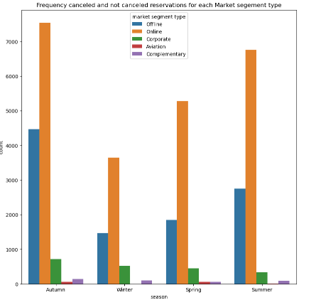
MARKET SEGMENT ANALYSIS
The graph also highlights seasonal variations within each market segment. For instance, the Online segment experiences peaks during certain seasons, which could be tied to promotional activities or seasonal demand

Slide 9
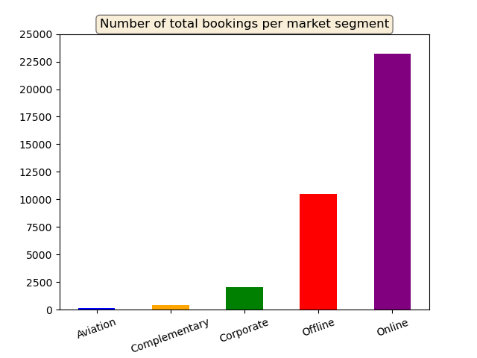
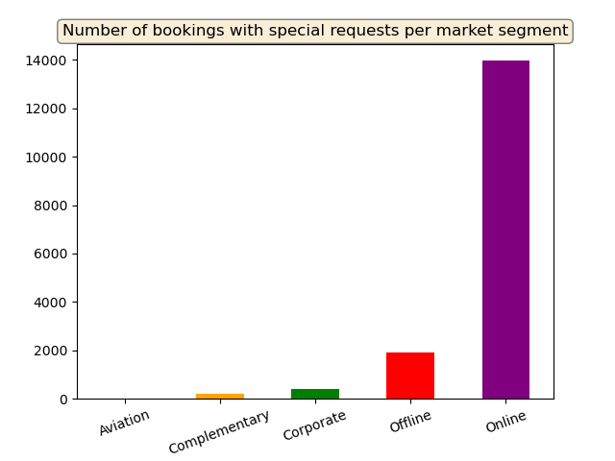
Bookings ANALYSIs
Most bookings are made online and they are the most likely to have a special request.

Slide 10
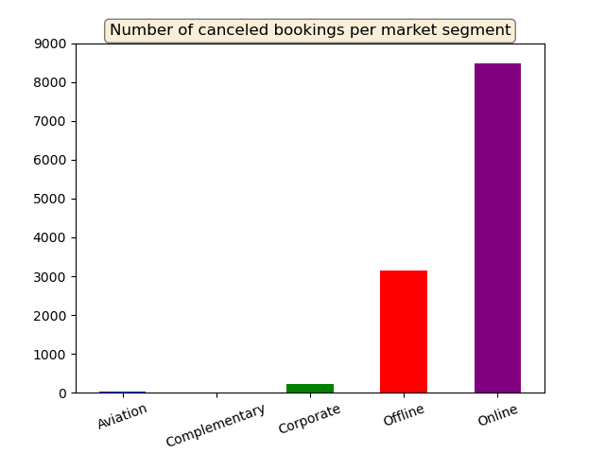
Canceled bookings ANALYSIs
Percentage of canceled bookings within each market segment:
Aviation: 29.6%
Complementary: 0%
Corporate: 10.9%
Offline: 29.9%
Online: 36.5%

Slide 11

Percentage of bookings that asked for parking space within each market segment
Aviation: 4.8%
Corporate: 9.1%
Complementary: 7.9%
Offline: 3.7%
Online: 0.3%

Slide 12
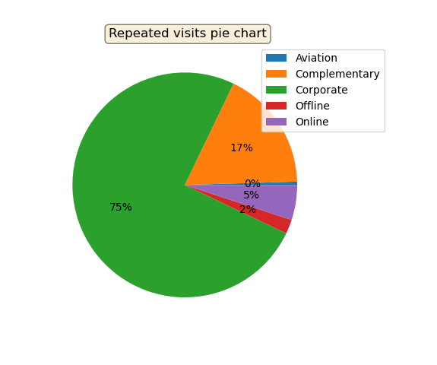
Visit Analysis
Average nights stayed per market segment:
Aviation: 4 nights
Complementary: 1.5 nights
Corporate: 2 nights
Offline: 3 nights
Online: 3 nights

Slide 13
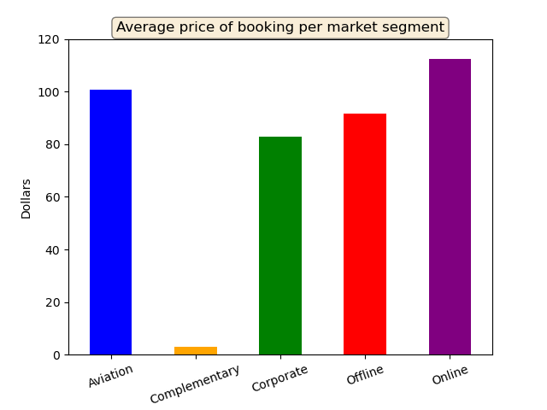
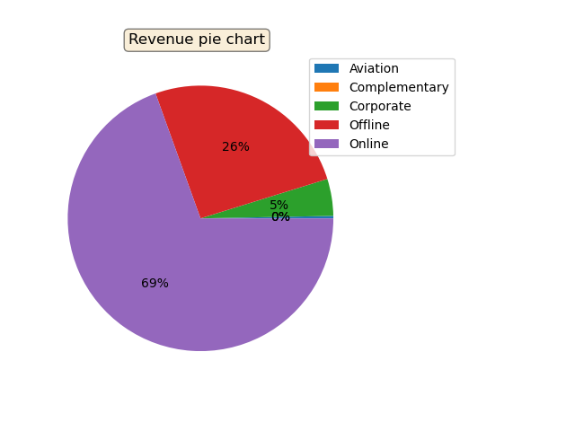
Revenue ANALYSIs
The majority of revenue comes from online bookings then offline ones.
Online bookings generate the most revenue per booking then aviation ones.

Slide 14
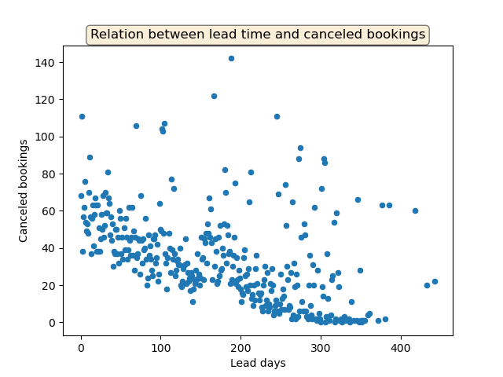
Lead Time VS. Cancelations
There is moderate negative correlation between lead time and number of canceled bookings.
Which means when more lead days are given before checking in, less bookings are canceled.

Slide 15
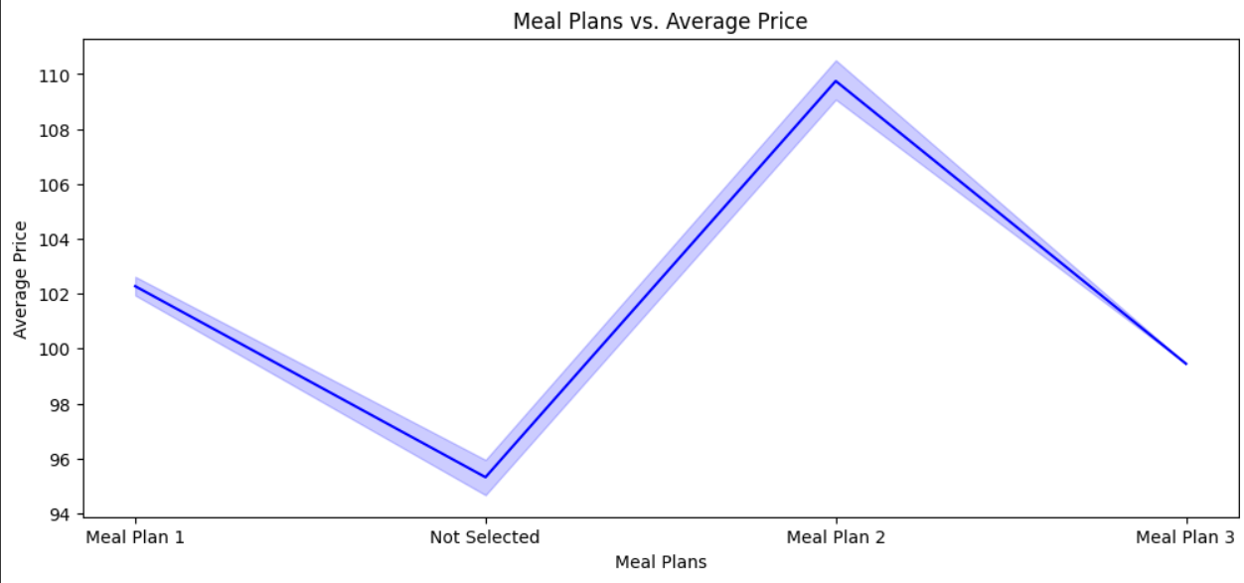
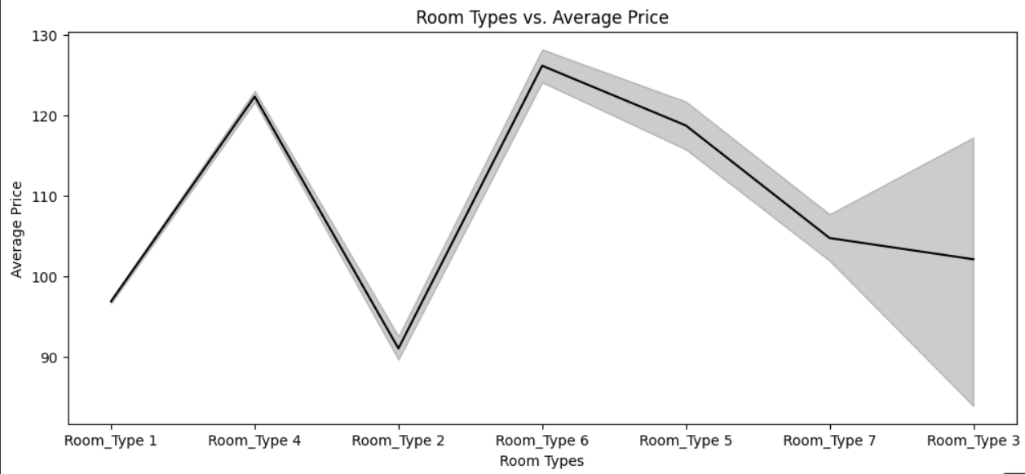
Meal plan 2 has the highest price on average in comparison with meal plan 1 and 3, while meal plan 1 is slightly higher than meal plan 3.
Room type 6 has the highest price on average in comparison with the other rooms, room type 4 comes next, then room 5, then room 7, then room 3 with great variation in its price, then room 1, then room 2 comes last as the lowest average price.

Slide 16
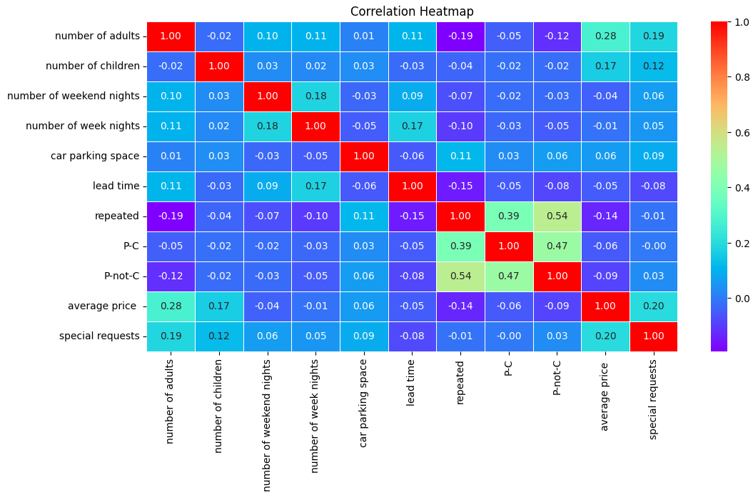
Correlation Graph

Slide 17
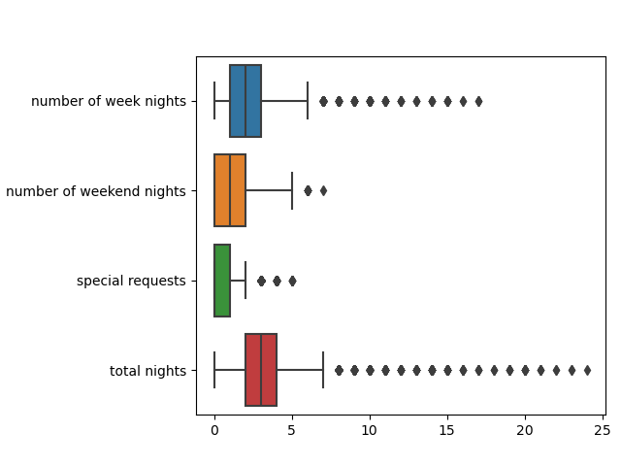
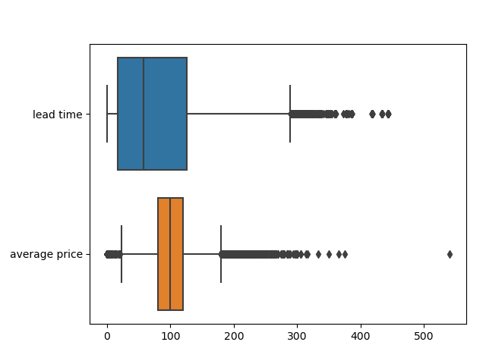
outliers Detection

